Slide 1

Points-to Analysis in Almost Linear Time
Authors: Bjarne Steensgaard
2022.1.9

Slide 2
Pointer Analysis
1、Concerned Statements
2、Andersen-style Pointer Analysis
3、Steensgaard-style Pointer Analysis
4、Steensgaard’s Type inference
1

Slide 3
Pointer Analysis
Concerned Statements
Pointer-Affecting Statements
Alloc
x = allocate(n)
Base
x = &y
Assign
x = y
Store
*x = y
Load
x = *y
2

Slide 4
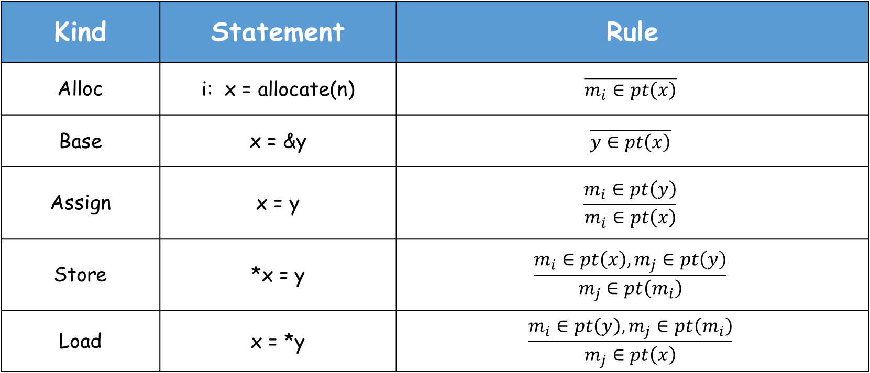
Pointer Analysis
Andersen-style Pointer Analysis
Kind | Statement | Rule
Alloc | i: x = allocate(n) | $$\overline{m_{i}∈pt\left(x\right)}$$
Base | x = &y | $$\overline{y∈pt\left(x\right)}$$
Assign | x = y | $$\frac{m_{i}∈pt\left(y\right)}{m_{i}∈pt\left(x\right)}$$
Store | *x = y | $$\frac{m_{i}∈pt\left(x\right),m_{j}∈pt\left(y\right)}{m_{j}∈pt\left(m_{i}\right)}$$
Load | x = *y | $$\frac{m_{i}∈pt\left(y\right),m_{j}∈pt\left(m_{i}\right)}{m_{j}∈pt\left(x\right)}$$
← unconditional
← premises
← conclusion
3

Slide 5


Pointer Analysis
Andersen-style Pointer Analysis
Rule: Alloc
$$\overline{m_{i}∈pt\left(x\right)}$$
Conclusion
$$m_{i}$$
i: x = allocate(n)
4

Slide 6

Pointer Analysis
Andersen-style Pointer Analysis
Rule: Base
$$\overline{y∈pt\left(x\right)}$$
Conclusion
y
x = &y
5

Slide 7
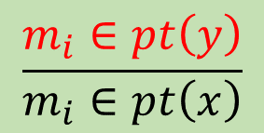

Pointer Analysis
Andersen-style Pointer Analysis
Rule: Assign
$$\frac{m_{i}∈pt\left(y\right)}{m_{i}∈pt\left(x\right)}$$
Premises
Conclusion
$$m_{i}$$
x = y
6

Slide 8
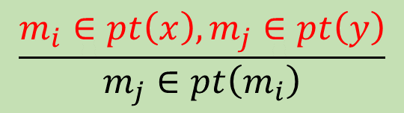


Pointer Analysis
Andersen-style Pointer Analysis
Rule: Store
$$\frac{m_{i}∈pt\left(x\right),m_{j}∈pt\left(y\right)}{m_{j}∈pt\left(m_{i}\right)}$$
Premises
Conclusion
$$m_{i}$$
$$m_{j}$$
*x = y
7

Slide 9
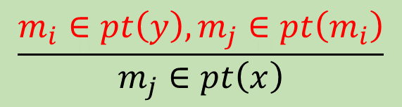


Pointer Analysis
Andersen-style Pointer Analysis
Rule: Load
$$\frac{m_{i}∈pt\left(y\right),m_{j}∈pt\left(m_{i}\right)}{m_{j}∈pt\left(x\right)}$$
Premises
Conclusion
$$m_{j}$$
$$m_{i}$$
x = *y
8

Slide 10
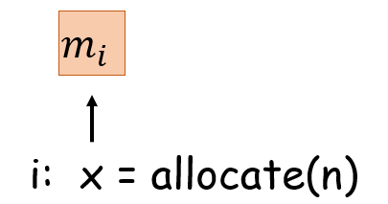
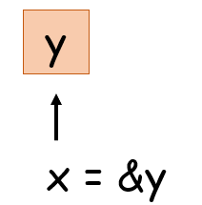
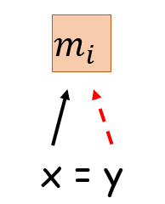
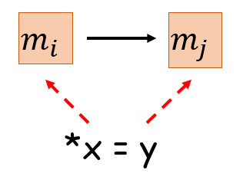
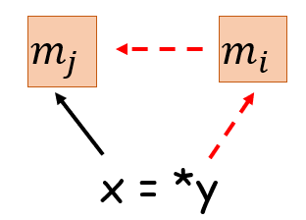
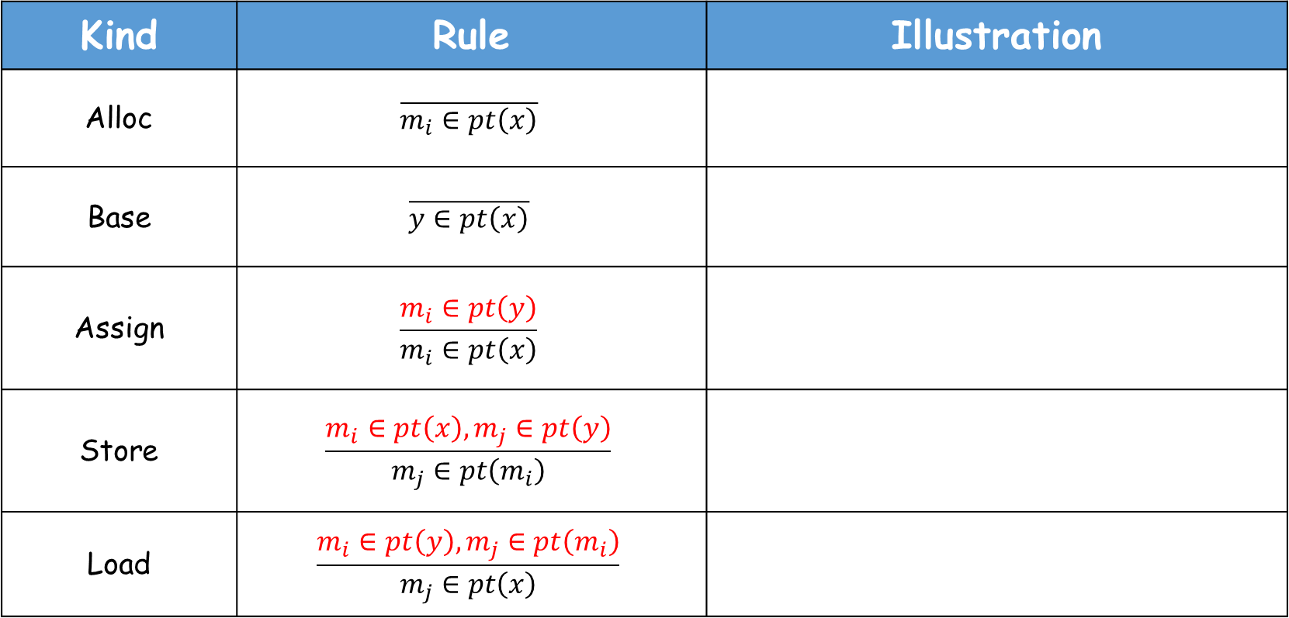
Pointer Analysis
Andersen-style Pointer Analysis
Kind | Rule | Illustration
Alloc | $$\overline{m_{i}∈pt\left(x\right)}$$
Base | $$\overline{y∈pt\left(x\right)}$$
Assign | $$\frac{m_{i}∈pt\left(y\right)}{m_{i}∈pt\left(x\right)}$$
Store | $$\frac{m_{i}∈pt\left(x\right),m_{j}∈pt\left(y\right)}{m_{j}∈pt\left(m_{i}\right)}$$
Load | $$\frac{m_{i}∈pt\left(y\right),m_{j}∈pt\left(m_{i}\right)}{m_{j}∈pt\left(x\right)}$$
9

Slide 11
Pointer Analysis
Andersen-style Pointer Analysis
Example
pts(p) = {m₁}
pts(q) = {b}
pts(r) = {c}
pts(s) = {m₁}
pts(t) = {b, c}
pts(m₁) = {b, c}
pts(b) = {}
pts(c) = {}
1. p = allocate(4);
2. q = &b;
3. *p = q;
4. r = &c;
5. s = p;
6. t = *p;
7. *s = r;
10

Slide 12
Pointer Analysis
Andersen-style Pointer Analysis
Algorithm
Initialize graph and points to sets using allocate、base and assign constraints
Let W = { v | pts(v) ≠∅ } (all nodes with non-empty points to sets)
While W not empty
v ← select from W
for each a ∈ pts(v) do
for each constraint p ⊇*v
add edge a→ p, and add a to W if edge is new
for each constraint *v ⊇ q
add edge q→a, and add q to W if edge is new
for each edge v→q do
pts(q) = pts(q) ∪ pts(v), and add q to W if pts(q) changed
O(n³)
11

Slide 13
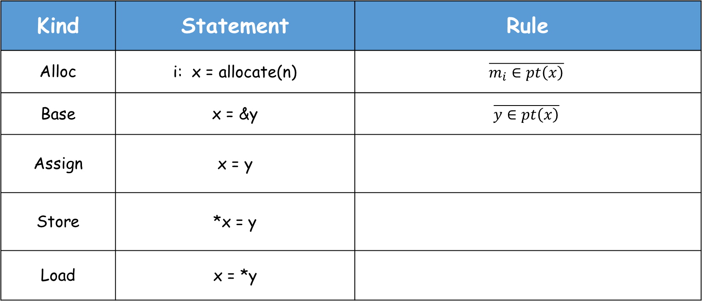
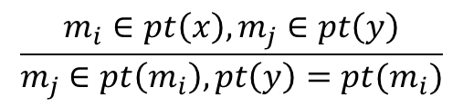
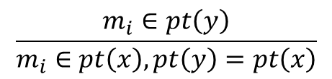
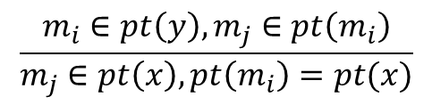
Pointer Analysis
Steensgaard-style Pointer Analysis
Kind | Statement | Rule
Alloc | i: x = allocate(n) | $$\overline{m_{i}∈pt\left(x\right)}$$
Base | x = &y | $$\overline{y∈pt\left(x\right)}$$
Assign | x = y
Store | *x = y
Load | x = *y
← unconditional
$$\frac{m_{i}∈pt\left(y\right)}{m_{i}∈pt\left(x\right),pt\left(y\right)=pt\left(x\right)}$$
← premises
← conclusion
$$\frac{m_{i}∈pt\left(x\right),m_{j}∈pt\left(y\right)}{m_{j}∈pt\left(m_{i}\right),pt\left(y\right)=pt(m_{i})}$$
$$\frac{m_{i}∈pt\left(y\right),m_{j}∈pt\left(m_{i}\right)}{m_{j}∈pt\left(x\right),pt\left(m_{i}\right)=pt(x)}$$
12

Slide 14
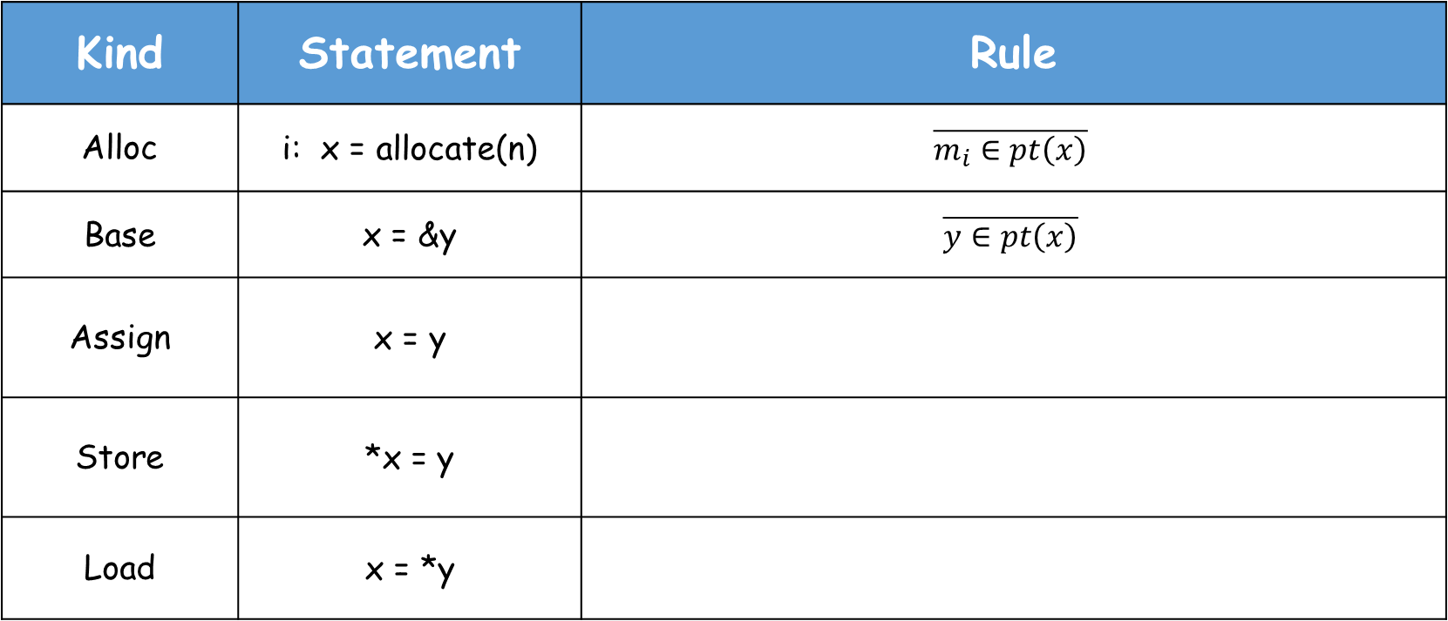
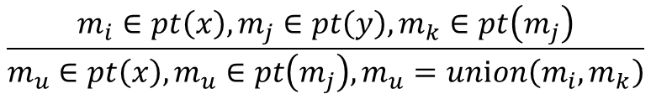
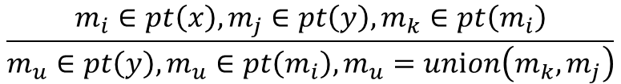
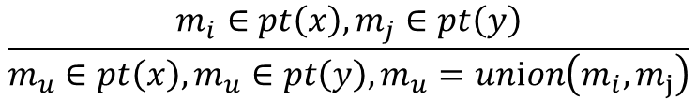
Pointer Analysis
Steensgaard-style Pointer Analysis
Kind | Statement | Rule
Alloc | i: x = allocate(n) | $$\overline{m_{i}∈pt\left(x\right)}$$
Base | x = &y | $$\overline{y∈pt\left(x\right)}$$
Assign | x = y
Store | *x = y
Load | x = *y
← unconditional
$$\frac{m_{i}∈pt\left(x\right),m_{j}∈pt\left(y\right)}{m_{u}∈pt\left(x\right),m_{u}∈pt\left(y\right),m_{u}=unⅈon\left(m_{i},m_{j}\right)}$$
← premises
← conclusion
$$\frac{m_{i}∈pt\left(x\right),m_{j}∈pt\left(y\right),m_{k}∈pt\left(m_{i}\right)}{m_{u}∈pt\left(y\right),m_{u}∈pt\left(m_{i}\right),m_{u}=unⅈon\left(m_{k},m_{j}\right)}$$
$$\frac{m_{i}∈pt\left(x\right),m_{j}∈pt\left(y\right),m_{k}∈pt\left(m_{j}\right)}{m_{u}∈pt\left(x\right),m_{u}∈pt\left(m_{j}\right),m_{u}=unⅈon\left(m_{i},m_{k}\right)}$$
12

Slide 15
Pointer Analysis
Steensgaard-style Pointer Analysis
Rule: Alloc
$$\overline{m_{i}∈pt\left(x\right)}$$
Conclusion
$$m_{i}$$
i: x = allocate(n)
13

Slide 16
Pointer Analysis
Steensgaard-style Pointer Analysis
Rule: Base
$$\overline{y∈pt\left(x\right)}$$
Conclusion
y
x = &y
14

Slide 17
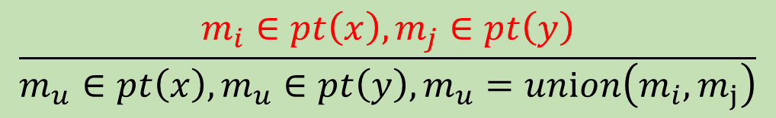



Pointer Analysis
Steensgaard-style Pointer Analysis
Rule: Assign
$$\frac{m_{i}∈pt\left(x\right),m_{j}∈pt\left(y\right)}{m_{u}∈pt\left(x\right),m_{u}∈pt\left(y\right),m_{u}=unⅈon\left(m_{i},m_{j}\right)}$$
Premises
Conclusion
$$m_{i}$$
$$m_{j}$$
$$m_{u}$$
x = y
15

Slide 18
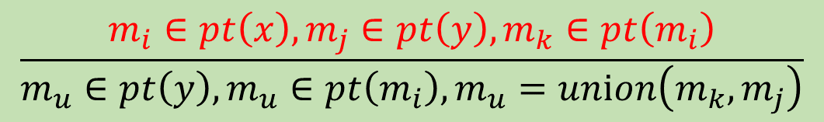




Pointer Analysis
Steensgaard-style Pointer Analysis
Rule: Store
$$\frac{m_{i}∈pt\left(x\right),m_{j}∈pt\left(y\right),m_{k}∈pt\left(m_{i}\right)}{m_{u}∈pt\left(y\right),m_{u}∈pt\left(m_{i}\right),m_{u}=unⅈon\left(m_{k},m_{j}\right)}$$
Premises
Conclusion
$$m_{k}$$
$$m_{j}$$
$$m_{u}$$
$$m_{i}$$
*x = y
16

Slide 19
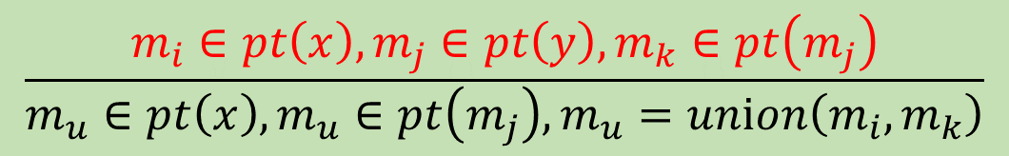



Pointer Analysis
Steensgaard-style Pointer Analysis
Rule: Load
$$\frac{m_{i}∈pt\left(x\right),m_{j}∈pt\left(y\right),m_{k}∈pt\left(m_{j}\right)}{m_{u}∈pt\left(x\right),m_{u}∈pt\left(m_{j}\right),m_{u}=unⅈon\left(m_{i},m_{k}\right)}$$
Premises
Conclusion
$$m_{i}$$
$$m_{k}$$
$$m_{u}$$
x = *y
$$m_{j}$$
17

Slide 20
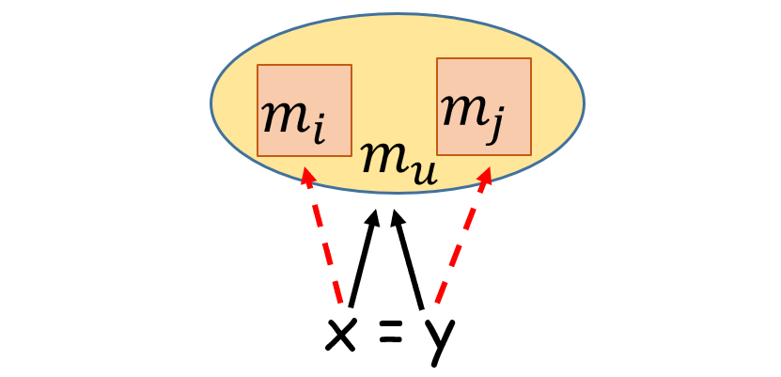
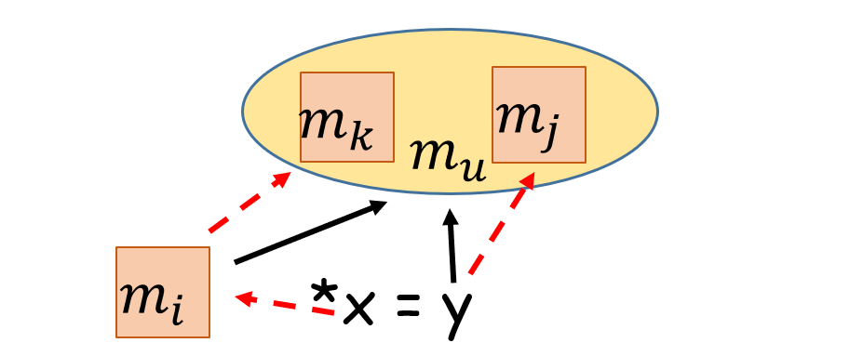
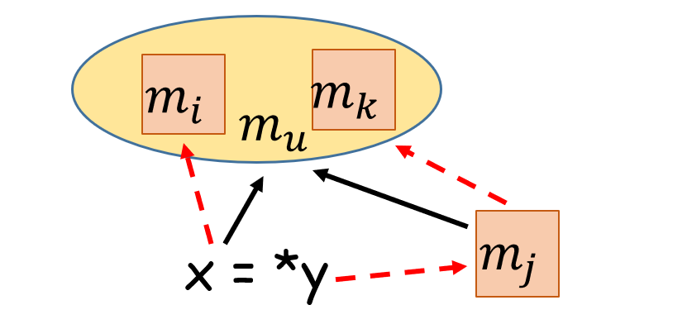
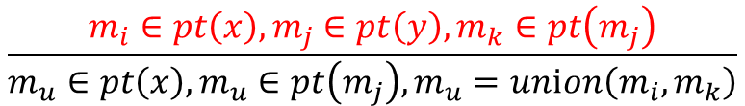
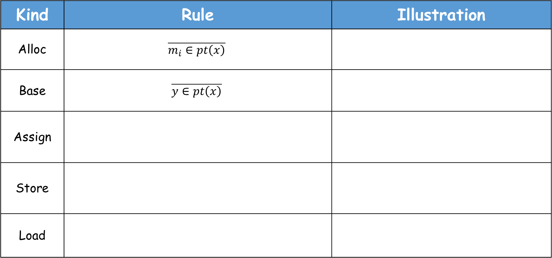
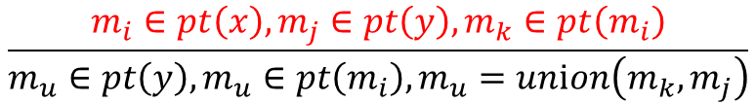
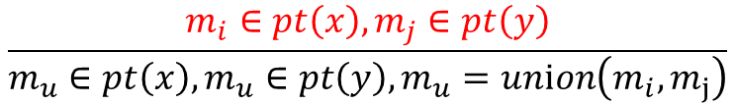
Pointer Analysis
Steensgaard-style Pointer Analysis
Kind | Rule | Illustration
Alloc | $$\overline{m_{i}∈pt\left(x\right)}$$
Base | $$\overline{y∈pt\left(x\right)}$$
Assign
Store
Load
$$\frac{m_{i}∈pt\left(x\right),m_{j}∈pt\left(y\right)}{m_{u}∈pt\left(x\right),m_{u}∈pt\left(y\right),m_{u}=unⅈon\left(m_{i},m_{j}\right)}$$
$$\frac{m_{i}∈pt\left(x\right),m_{j}∈pt\left(y\right),m_{k}∈pt\left(m_{i}\right)}{m_{u}∈pt\left(y\right),m_{u}∈pt\left(m_{i}\right),m_{u}=unⅈon\left(m_{k},m_{j}\right)}$$
$$\frac{m_{i}∈pt\left(x\right),m_{j}∈pt\left(y\right),m_{k}∈pt\left(m_{j}\right)}{m_{u}∈pt\left(x\right),m_{u}∈pt\left(m_{j}\right),m_{u}=unⅈon\left(m_{i},m_{k}\right)}$$
18

Slide 21
Pointer Analysis
Steensgaard-style Pointer Analysis
Example
pts(p) = {m₁}
pts(q) = {m_{u}}
pts(r) = {m_{u}}
pts(s) = {m₁}
pts(t) = {m_{u}}
pts(m₁) = {m_{u}}
pts(m_{u}) = {}
1. p = allocate(4);
2. q = &b;
3. *p = q;
4. r = &c;
5. s = p;
6. t = *p;
7. *s = r;
m_{u} = union(b, c}
19

Slide 22
Pointer Analysis
Steensgaard’s Type inference
Key ideas
The algorithm, which is inspired by Henglein’s binding time analysis by type inference [Hen91], uses a non-standard type system to describe the store usage at runtime by using types to construct a storage shape graph.
The typing rules impose constraints on the relationships of types of program variables. Finding a typing of the program that obeys these constraints amounts to performing a points-to analysis.
20

Slide 23






Pointer Analysis
Steensgaard’s Type inference
Non-standard type system
$$α≔τ×λ$$
$$α≔τ$$
$$τ ≔\left.⊥ \right| rⅇf\left(α\right)$$
$$τ ≔\left.⊥ \right| rⅇf\left(α\right)$$
$$λ ≔\left.⊥ \right| \operatorname{lam}\left(α_{1}…α_{n}\right)\left(α_{n+1}…α_{n+m}\right)$$
The types$α$ describe values, the types $τ$ describe locations (or pointers to locations), and the $λ$ types describe functions (or pointers to functions).
For simplicity, only the types $τ$ are considered here.
21

Slide 24

















Pointer Analysis
Steensgaard’s Type inference
Typing rules (Constraints)
Alloc
$A⊢x :rⅇf\left(ref(_\right)$)
$$A⊢x :rⅇf\left(ref{(α}_{1})\right)$$
$$\overline{A⊢welltyped(x\text{ = }\text{allocate}\text{(}\text{n}\text{)}\text{)}}$$
Store
$$A⊢y :rⅇf\left(α_{2}\right)$$
$$α_{2}⊴α_{1}$$
$$\overline{A⊢welltyped(\text{∗}\text{x}\text{ = }\text{y}\text{)}}$$
$$A⊢x :rⅇf\left(τ\right)$$
Base
$$A⊢y :τ$$
$$\overline{A⊢welltyped(x\text{ = }\&\text{y}\text{)}}$$
$$A⊢y :rⅇf\left(α_{1}\right)$$
Load
$$A⊢x :rⅇf\left(ref{(α}_{2})\right)$$
$$α_{2}⊴α_{1}$$
$$A⊢x :rⅇf\left(α_{1}\right)$$
$$\overline{A⊢welltyped(\text{x}\text{ = }\text{∗}\text{y}\text{)}}$$
Assign
$$A⊢y :rⅇf\left(α_{2}\right)$$
$$α_{2}⊴α_{1}$$
$$α_{2}⊴α_{1} ⇔ \left(α_{2}= ⊥\right)∨\left(α_{2}=α_{1}\right)$$
$$\overline{A⊢welltyped(x\text{ = }\text{y}\text{)}}$$
“_” is a wild-card value in the rules, imposing no restrictions on the type component it represents.
22

Slide 25

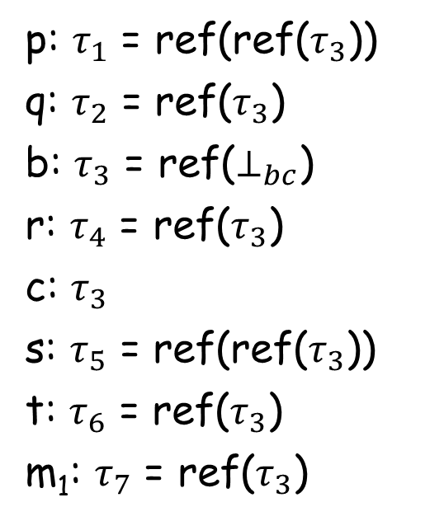






Pointer Analysis
Steensgaard’s Type inference
Example
1. p = allocate(4);
2. q = &b;
3. *p = q;
4. r = &c;
5. s = p;
6. t = *p;
7. *s = r;
p: $τ_{1}$ = ref(ref($τ_{3}$))
q: $τ_{2}$ = ref($τ_{3}$)
b: $τ_{3}$ = ref($⊥_{bc}$)
r: $τ_{4}$ = ref($τ_{3}$)
c: $τ_{3}$
s: $τ_{5}$ = ref(ref($τ_{3}$))
t: $τ_{6}$ = ref($τ_{3}$)
m₁: $τ_{7}$ = ref($τ_{3}$)
$τ_{7}$
m₁
$τ_{1}$
p
$τ_{2}$
q
b, c
$τ_{3}$
$τ_{4}$
r
$τ_{5}$
s
$τ_{6}$
t
23

Slide 26
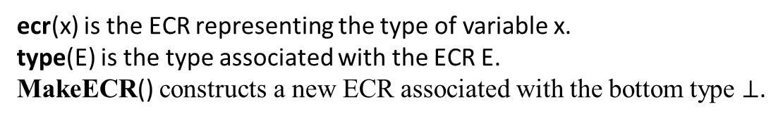
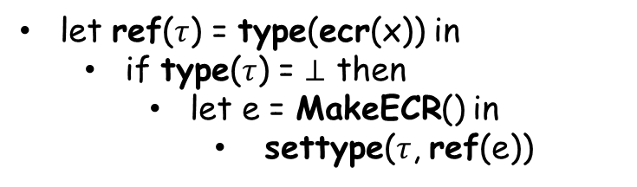
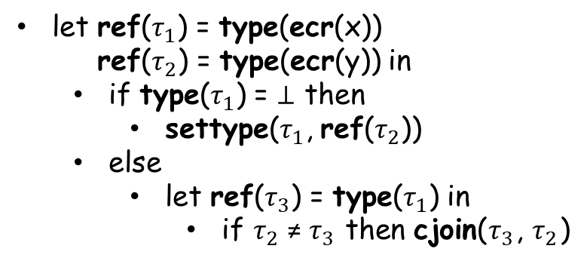
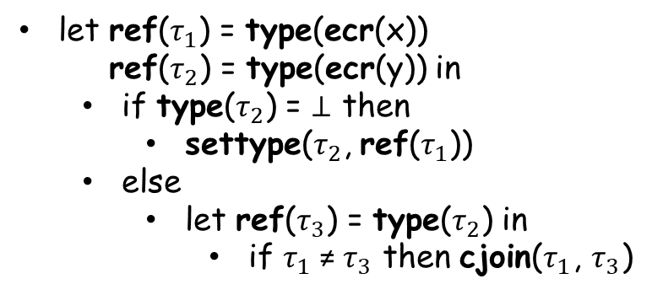
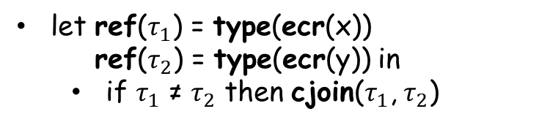
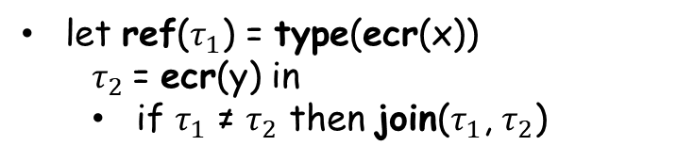
Pointer Analysis
Steensgaard’s Type inference
ecr(x) is the ECR representing the type of variable x.
type(E) is the type associated with the ECR E.
MakeECR() constructs a new ECR associated with the bottom type $⊥$.
Inference rules
let ref($τ$) = type(ecr(x)) in
if type($τ$) = $⊥$ then
let e = MakeECR() in
settype($τ$, ref(e))
let ref($τ_{1}$) = type(ecr(x))
ref($τ_{2}$) = type(ecr(y)) in
if type($τ_{1}$) = $⊥$ then
settype($τ_{1}$, ref($τ_{2}$))
else
let ref($τ_{3}$) = type($τ_{1}$) in
if $τ_{2}$ ≠ $τ_{3}$ then cjoin($τ_{3}$, $τ_{2}$)
Alloc
Store
Base
let ref($τ_{1}$) = type(ecr(x))
$τ_{2}$= ecr(y) in
if $τ_{1}$ ≠ $τ_{2}$ then join($τ_{1}$, $τ_{2}$)
let ref($τ_{1}$) = type(ecr(x))
ref($τ_{2}$) = type(ecr(y)) in
if type($τ_{2}$) = $⊥$ then
settype($τ_{2}$, ref($τ_{1}$))
else
let ref($τ_{3}$) = type($τ_{2}$) in
if $τ_{1}$ ≠ $τ_{3}$ then cjoin($τ_{1}$, $τ_{3}$)
Load
Assign
let ref($τ_{1}$) = type(ecr(x))
ref($τ_{2}$) = type(ecr(y)) in
if $τ_{1}$ ≠ $τ_{2}$ then cjoin($τ_{1}$, $τ_{2}$)
24

Slide 27
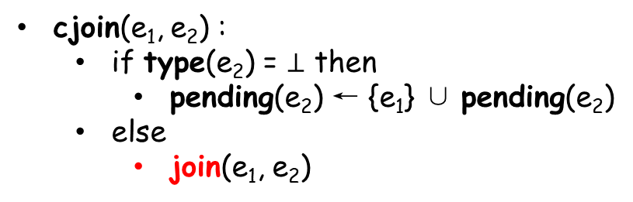
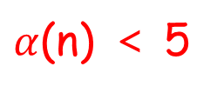
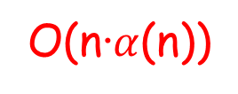
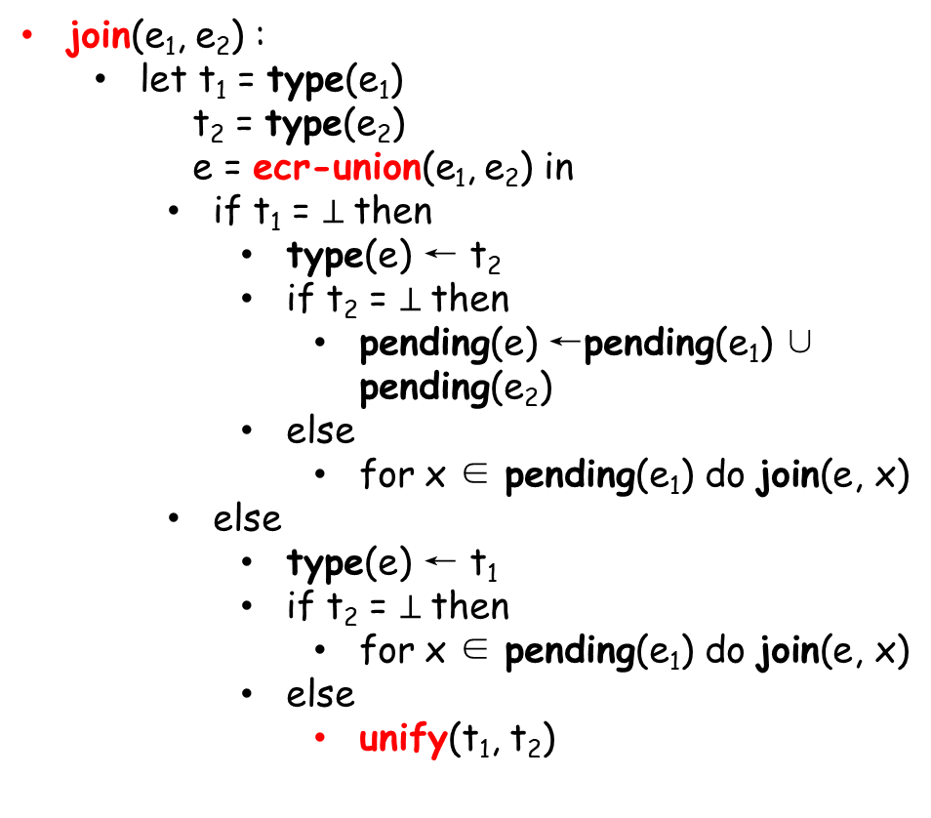

Pointer Analysis
Steensgaard’s Type inference
Inference rules
join(e₁, e₂) :
let t₁ = type(e₁)
t₂ = type(e₂)
e = ecr-union(e₁, e₂) in
if t₁ = $⊥$then
type(e) ← t₂
if t₂ = $⊥$then
pending(e) ←pending(e₁) ∪ pending(e₂)
else
for x ∈ pending(e₁) do join(e, x)
else
type(e) ← t₁
if t₂ = $⊥$then
for x ∈ pending(e₁) do join(e, x)
else
unify(t₁, t₂)
O(n·$α$(n))
settype(e, t) :
type(e) ← t
for x ∈ pending(e) do join(e, x)
$α$(n) ＜ 5
cjoin(e₁, e₂) :
if type(e₂) = $⊥$ then
pending(e₂) ← {e₁} ∪ pending(e₂)
else
join(e₁, e₂)
unify(ref($τ_{1}$), ref($τ_{2}$)) :
if $τ_{1}$ ≠ $τ_{2}$ then join($τ_{1}$, $τ_{2}$)
25

